Slide 1
Tactical and Strategic Approaches for a Meaningful Relationship in Policy Development
Sarah Allan, Engagement Lead
Involve
@InvolveUK @SarahAllanUK

Slide 2
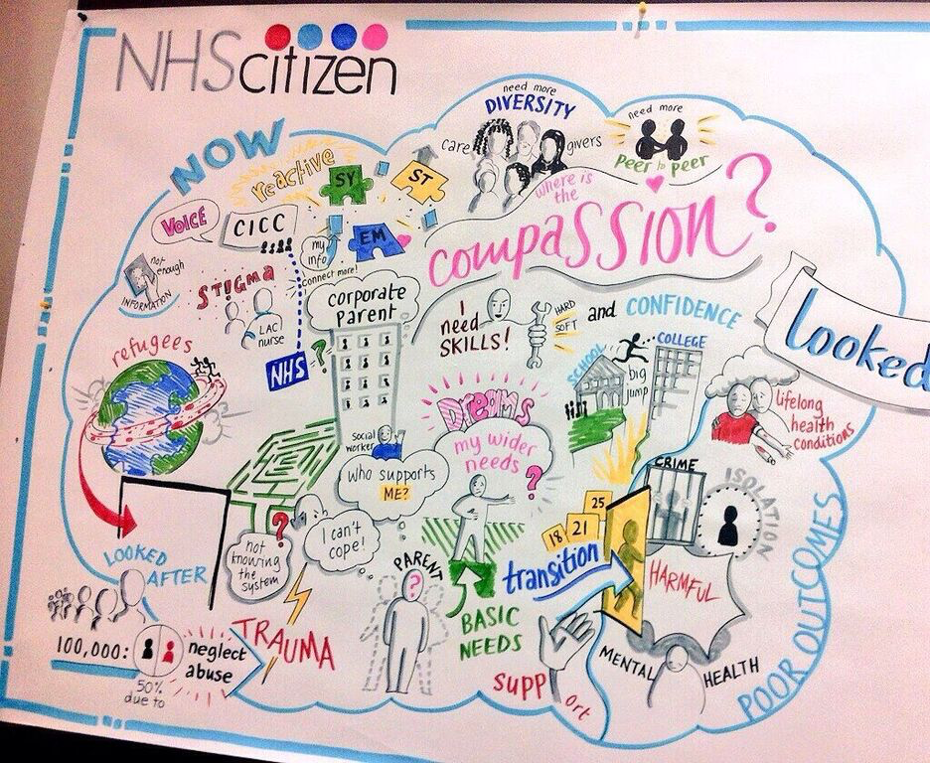
Introducing Involve

Slide 3
Contents
Different sectors, different starting points
Designing effective engagement
Engagement methods

Slide 4
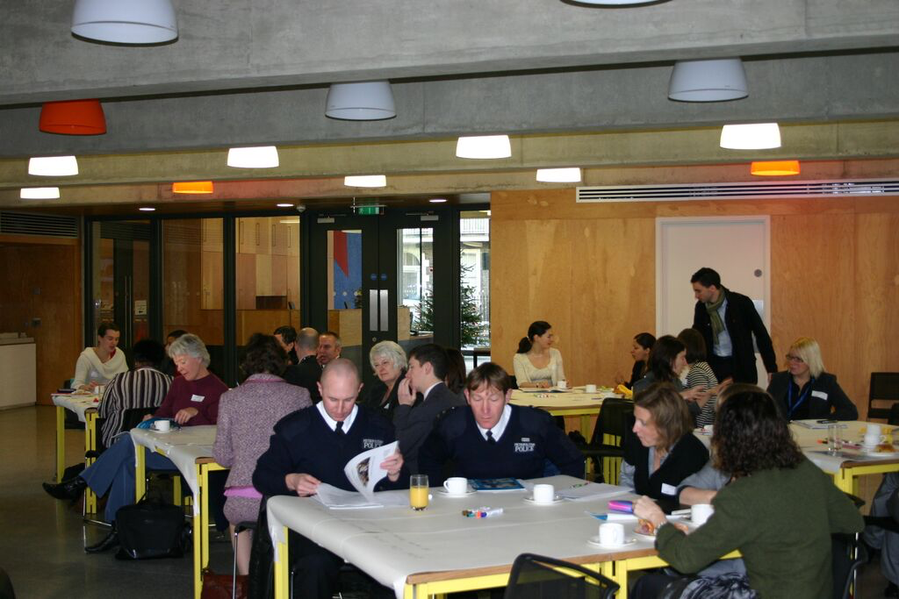
Different sectors, different starting points

Slide 5
Motivations and aims
Perspectives
Considerations and fears

Slide 6
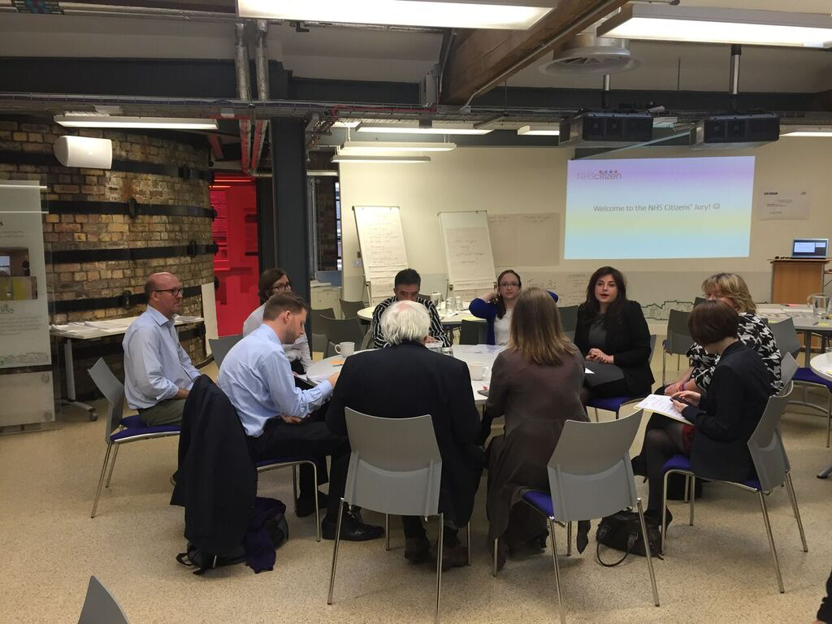
Designing effective engagement

Slide 7
The key design questions
Scope: What’s open to change (and what’s not)? What level of engagement?
Purpose: Why is the engagement happening? What does the public know that you don’t?
Outcomes: What, specifically, should the engagement process achieve?
Outputs: What should the engagement process produce (eg a report)?
Notes:
Are copies on your table
Purpose: What knowledge do public (or wider stakeholder engaging have) that no one else does?
Outcomes: Secondary outcomes

Slide 8
Participants: Who needs to take part for the above to be achieved
Budget
Timescales
Institutional response: When and how will the relevant decision-maker(s) review the results of the engagement process and respond?

Slide 9
Levels of engagement
Inform: Provision of information
Consult: Obtaining feedback, for example on analysis or alternatives
Involve: Working directly with the public to answer a pre-set question
Collaborate: To partner with the public in each aspect of the decision, including defining the question
Empower: To place final decision-making in the hands of the public
Notes:
you can use the levels as a frame and go a little deeper - give some thoughts about what are or might be the expectations of government-stakeholders on each of these levels

Slide 10
Why use these questions?
Manage expectations
Buy-in, trust, understanding
Notes:
How to guarantee that all participants understand the engagement design, the action plan is good for the objective and desired outcome.

Slide 11
How to answer the questions
By yourself
With internal stakeholders
With external stakeholders
Collaboration doesn’t have to stop there…
Notes:
How to guarantee that all participants understand the engagement design, the action plan is good for the objective and desired outcome.

Slide 12
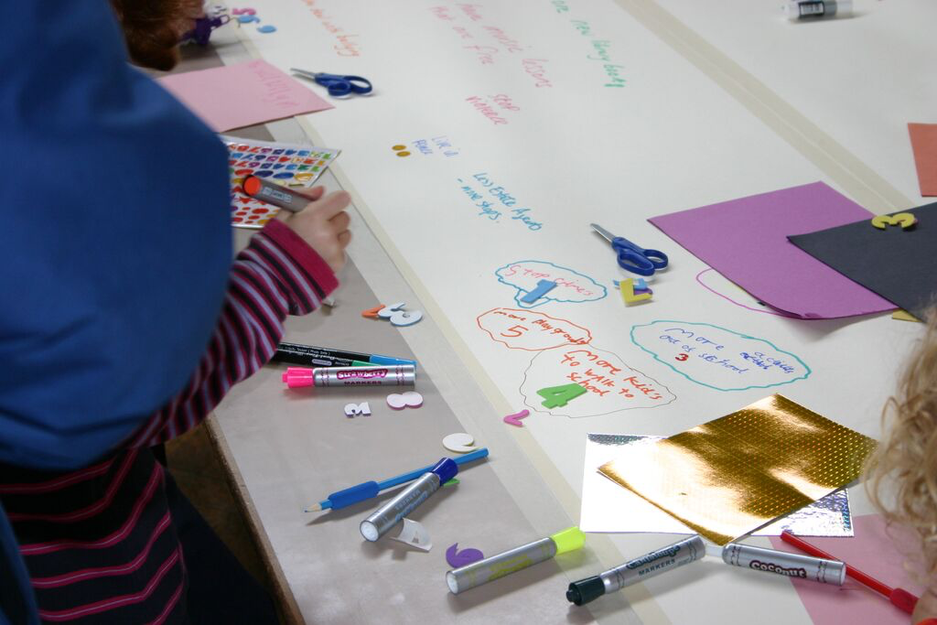
Engagement methods

Slide 13
Pop up democracy:
Any technique that uses temporary, site-specific methods to engage people – eg stalls in supermarkets, going to community groups.
Example: Transport for London in Northwood.
Citizens’ Jury:
Like a jury in a criminal trial, this process brings together a small number of people to listen to, and discuss, detailed evidence before agreeing a solution or recommendation.
Example: Melbourne City Council.
Deliberative workshop:
Facilitated events which bring decision-makers, civil society and/or members of the public together to discuss key issues. Usually offline, but can be online.
Example: Newham Clinical Commissioning Group workshop.
Community champions:
Training members of the community you are trying to reach to conduct the engagement, and usually develop engagement content, for you.
Examples: London Borough of Lambeth Youth Council, and East London Foundation Trust.

Slide 14
Useful websites
The eight steps:
www.involve.org.uk then ‘People and Participation’
Understanding motivations and expectations:
www.pathwaysthroughparticipation.org.uk (for the public)
www.involve.org.uk then ‘Public engagement, not just about the public’ (for civil society and decision-makers)
Engagement methods and case studies:
www.participationcompass.org
www.civicactivism.buildingchangetrust.org
http://www.govint.org/good-practice/case-studies/
www.participedia.net
Notes:
Say can use other methods

Slide 15
Any questions?
Notes:
Are going to go round and help
Shall I explain what going to do first

Slide 16
Thank you
Sarah Allan
Engagement Lead, Involve
@InvolveUK @SarahAllanUK
Notes:
Are going to go round and help
Shall I explain what going to do first

